Slide 1
Presentation to Joint Bond Bill Committee
Slides for the
Executive Session
April 26, 2004

Slide 2
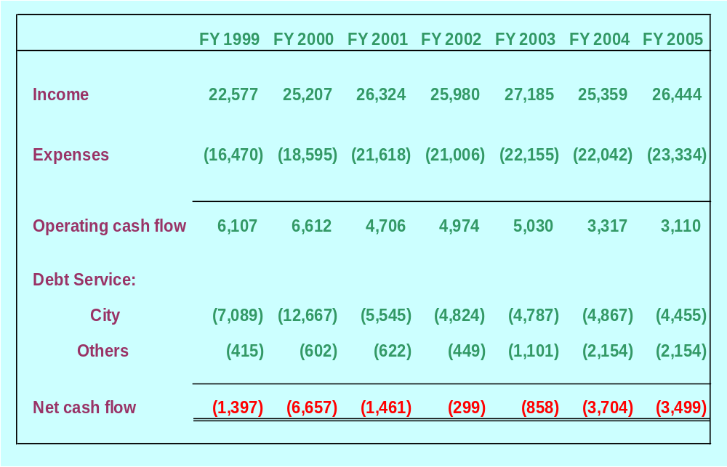
Cash Flow: FY 1999-2005
(in $ ‘000)

Slide 3
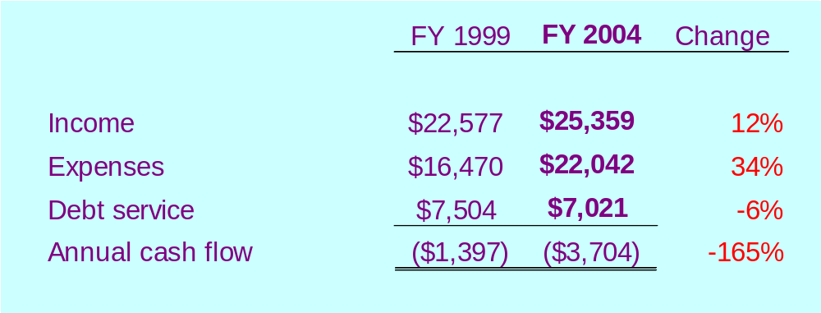
Changes since FY 1999
Stiff competition from subsidized neighboring ports limited price increases

Slide 4
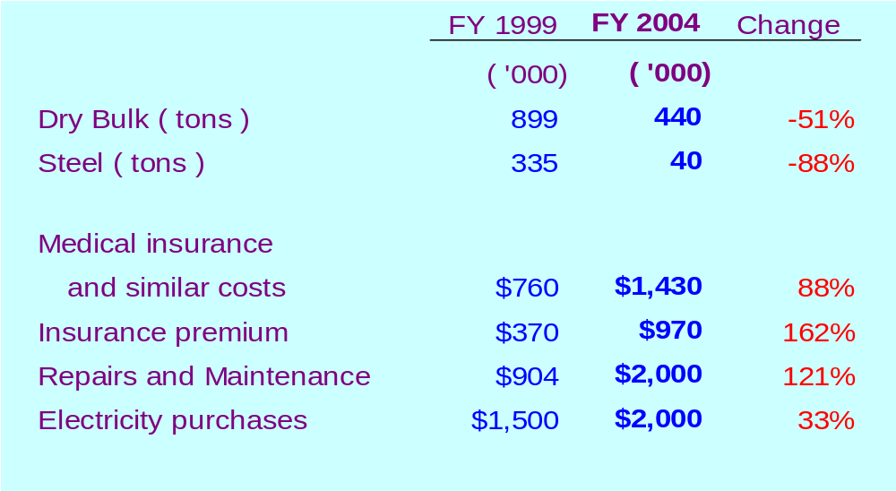
Changes since FY 1999

Slide 5
Subsidies at other ports
All major ports (except LA area) receive direct ongoing State and Local government subsidies or are cross-subsidized from bridges, airports, etc.
Seattle –Tacoma receive a share of property taxes
For FY 2003, Virginia Port Authority received $30 million from gasoline and motor vehicle taxes
In FY 2002 alone, PA provided debt service support worth $8.8 million, NJ provided $5.1 million;
MD provides 100% funding for capital, operations and debt service of the Port of Baltimore each year
Request appropriation of $2 million to meet operating expenses in FY 2005

Slide 6
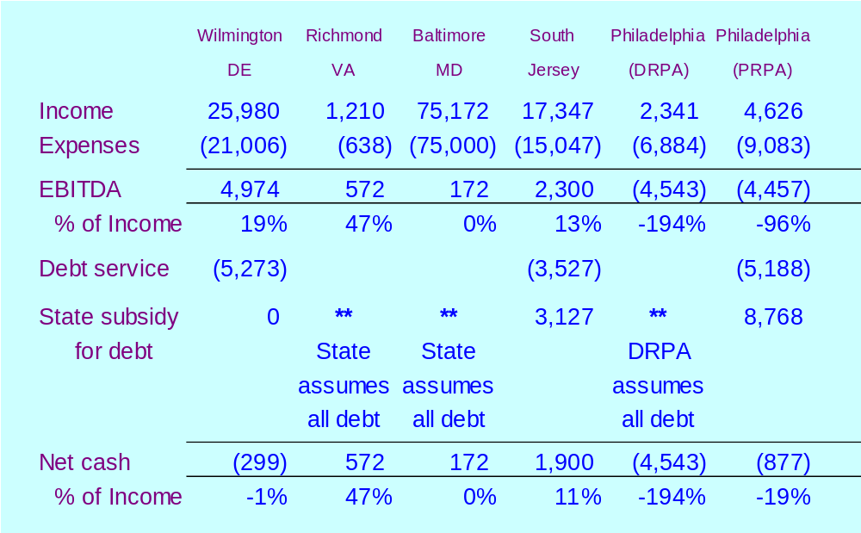
Subsidies provided to competing ports for FY 2002 ($ ‘000)

Slide 7
Competition from subsidized ports
Subsidized ports do not feel the same pressure to recover full costs
Competing ports undercut prices or create facilities to entice customers in order to increase economic development
Offers from competitors to entice result in existing customers seeking reduced rates
Occasionally this results in the loss of a customer
Examples: Banacol, C & S, Delmonte, Jugos del Sur, Volkswagen

